Slide 1

DEEP LEARNING FOR CLASSIFICATION
Rıdvan Söyü
2017911334

Slide 2









1 What is Deep Learning?
2 What Makes Deep Learning «Deep»?
3 Deep Learning Advantages
CONTENTS
4 Deep Learning Use Cases
5 Why is Deep Learning Popular?
6 Deep Learning For Classification
7 Brief Explanation of Project

Slide 3







DATA SCIENCE LANDSCAPE
Data Analytics
Machine Learning
Graph Analytics
SQL Query
Traditional Methods
Deep Neural Networks
Regression
SVM
Recommender systems

Slide 4
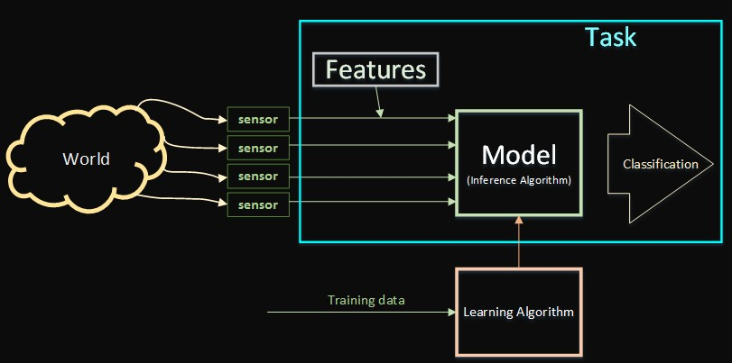
WHAT IS DEEP LEARNING?
Deep Learning is a set of algorithms in machine learning that attempt to model high-level abstraction in data by using architectures composed of multiple non-linear transformations.
Key components
Task Features Model
Learning Algorithm

Slide 5

WHAT MAKES DEEP LEARNING DEEP?
Neural networks can be recurrent or feed forward
Feed forward ones do not have any loops
If there are «many layers», then the network is «deep»
No definite layer number to qualify as deep
Having two or more hidden layers counts as deep

Slide 6






































































































































Non-deep feedforward
neural network
Input
Result
Deep neural network
Input
Result

Slide 7









DEEP LEARNING ADVANTAGES
Deep Learning
Parallel algorithms, multiple tasks at same time.
Same approach is available for different problems.
Fault tolerant.
Scales well.
Support Vector Machine
Bayesian
Linear classifier
Regression Decision Trees
Clustering
Association Rules

Slide 8

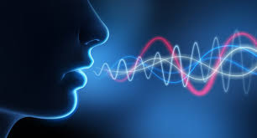

DEEP LEARNING USE CASES
SOUND
Voice recognition
Voice search
Sentiment analysis
Flaw detection.
Fraud detection
Automotive, Security
Handset maker, Telecoms
CRM
Automotive, Aviation
Finance, Credit cars
IN

Slide 9
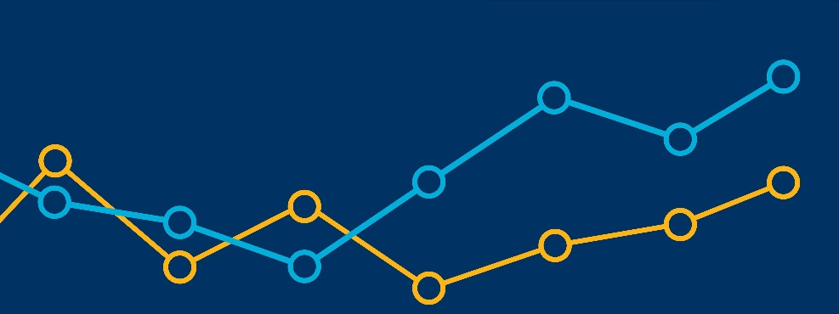
DEEP LEARNING USE CASES
TIME SERIES
Log analysis
Recommendation engine
Risk detection
Sensor data
Economic analytics
Data Centers, Security
E-Commerce, Social media
Finance
IoT, Smart Home
Accounting, Governments
IN

Slide 10







WHY IS DEEP LEARNING POPULAR?
Three Main Reasons:
Accuracy
Efficency
Flexibility
MNIST
0.21% error rate
Increased the energy efficiency of Google’s data centers by 15 %
DeepMind
Caffe2
Lightweight, modular and scalable deep learning framework
DeepFace
97.35% accuracy

Slide 11
DEEP LEARNING FOR CLASSIFICATION
All classification task depend upon labeled datasets
Supervised learning
Detect faces
Identify objects in images
Recognize gestures in video
Detect voices
Recognize sentiment in text
→
→
→
→
→
Recognize facial expressions
Stop signs, line markers
Detect human or object
Identify speakers
Identify customer feedback

Slide 12
Thank you for listening
☺

